Slide 1



Confident Conversations in Research
Emma Law and Jacqui Kerr

Slide 2
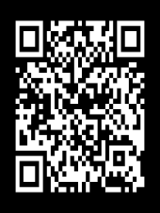


Confident Conversations about Research with Alzheimer Scotland
Joint working with Alzheimer Scotland
Training for all staff about research conversations
Toolkit for confident conversations
Excellent feedback
Widening access
www.nrs.org.uk/NDN
@NRS_NDN Take part in research:

Slide 3

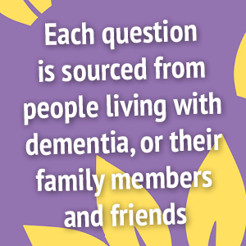
Joint working
Working group/host venues/materials
Trial expertise/deliver training/content

Slide 4
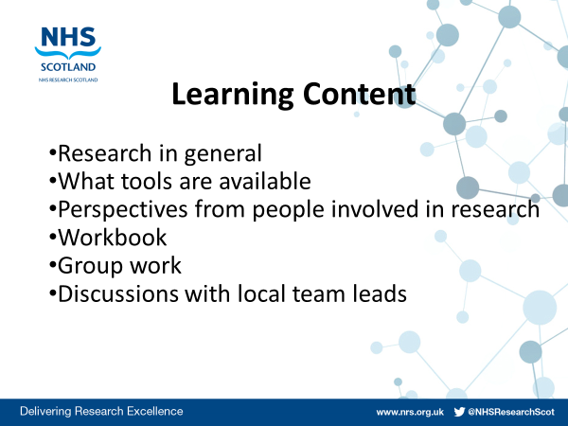

Slide 5
How confident are you in talking to people about research on a scale of 1-10?
1 | 2 | 3 | 4 | 5 | 6 | 7 | 8 | 9 | 10
Not at all confident
I’m a pro!

Slide 6


Slide 7

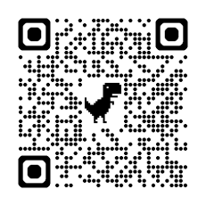
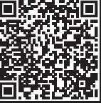

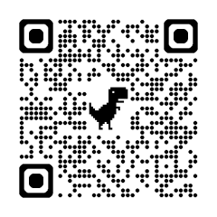

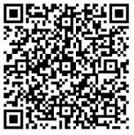

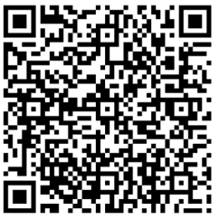
CONFIDENT CONVERSATIONS TOOLKIT
An easy-to-use service which allows people to register their interest in dementia research so they can be contact about relevant research studies
www.joindementiaresearch.nihr.ac.uk
An easy-to-use service which allows people to register their interest in dementia research so they can be contact about relevant research studies
www.nrs.org.uk/dementia
PERMISSION TO CONTACT
The Alzheimer Scotland Brain Tissue Bank accept donations of brain tissue from people with dementia, to assist research now and in the future
alzscotdrc@ed.ac.uk
BRAIN TISSUE BANK
Involving patients, carers and the public as vital research partners, supporting the work of the Neuroprogressive and Dementia Network (NDN)
Tay.PPIPartners@nhs.scot
Enabling research in care homes by bringing together care home staff, residents and researchers
www.nrs.org.uk/enrich

Slide 8

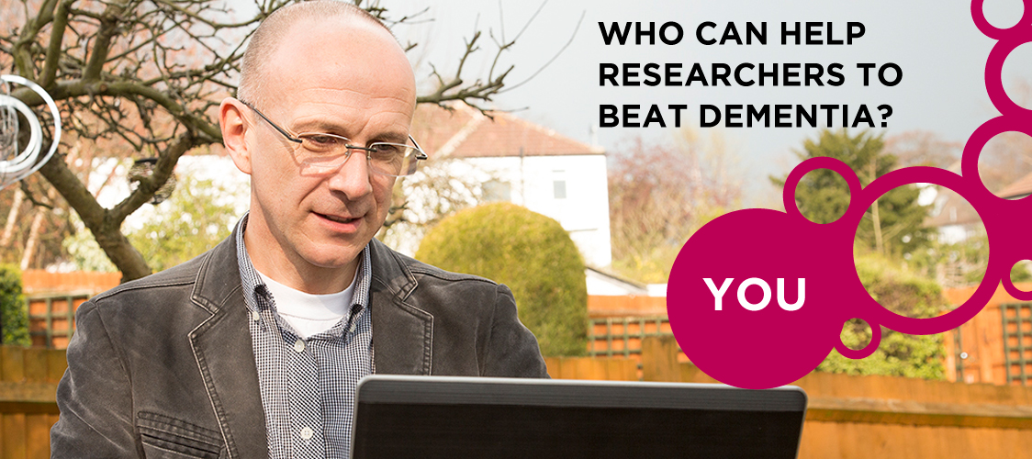
Join Dementia Research
https://www.youtube.com/watch?v=brHA9clVZsg

Slide 9



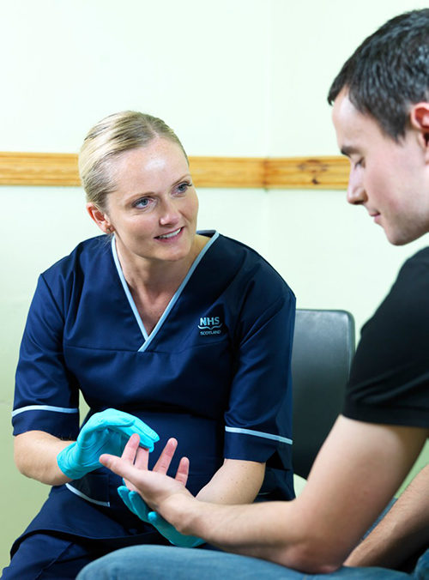
Permission to contact

Slide 10

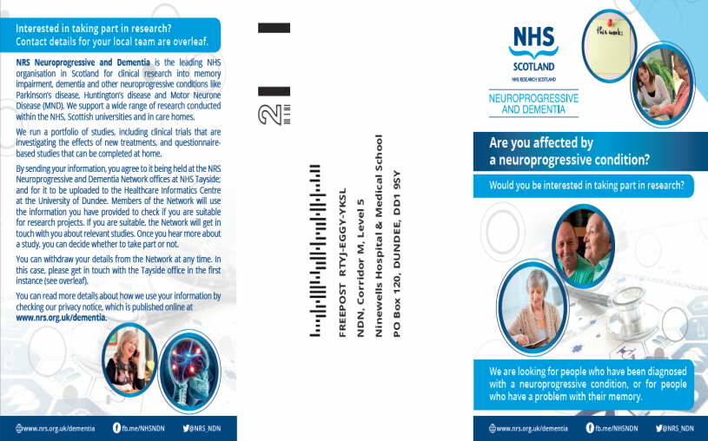
PTC Process
Name
Date of birth
Diagnosis (if any)
Method of contact
Permission to store
Permission to access
Permission to contact
Upload to Health Informatics Centre in University of Dundee

Slide 11
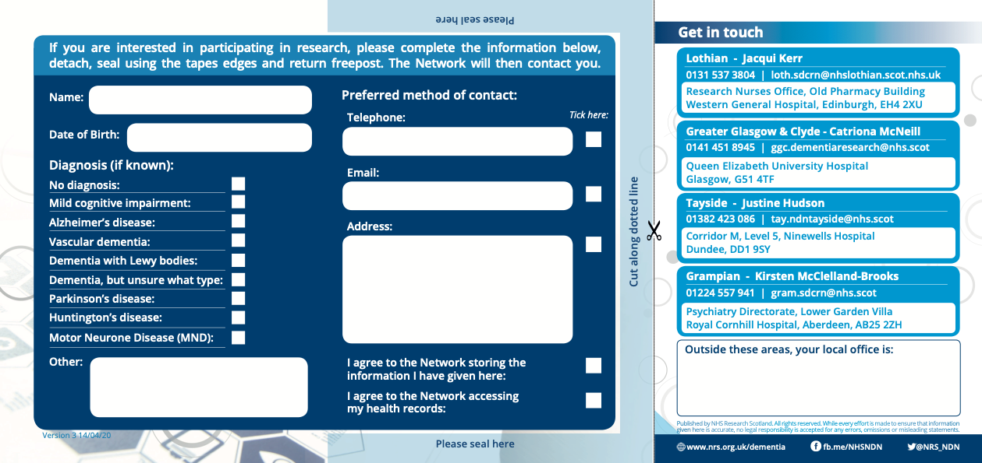

‘Permission to Contact’ research interest register
www.nrs.org.uk/NDN
@NRS_NDN Take part in research:

Slide 12




Alzheimer Scotland
Dementia Brain Tissue Bank

Slide 13
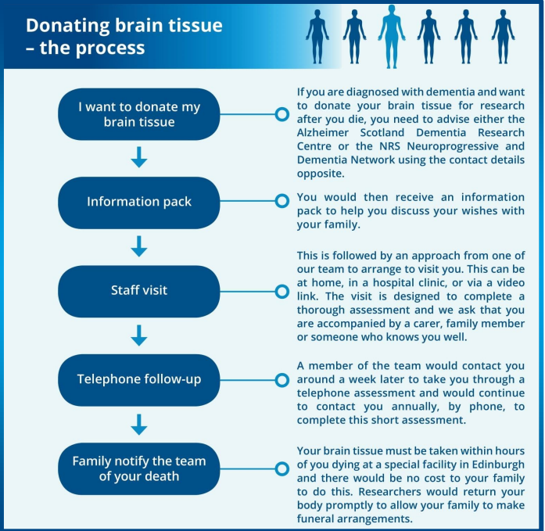


Slide 14


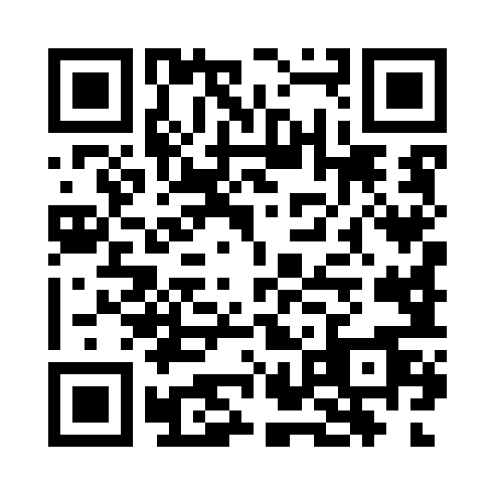
Partners in Research – our lived experience group
www.nrs.org.uk/NDN
@NRS_NDN Take part in research:

Slide 15
Widening Access
AHPs
Other NHS staff
Health Improvement Scotland
Remote and Rural areas
Included in the Alzheimer Scotland training plan - April 2024/25
European colleagues

Slide 16
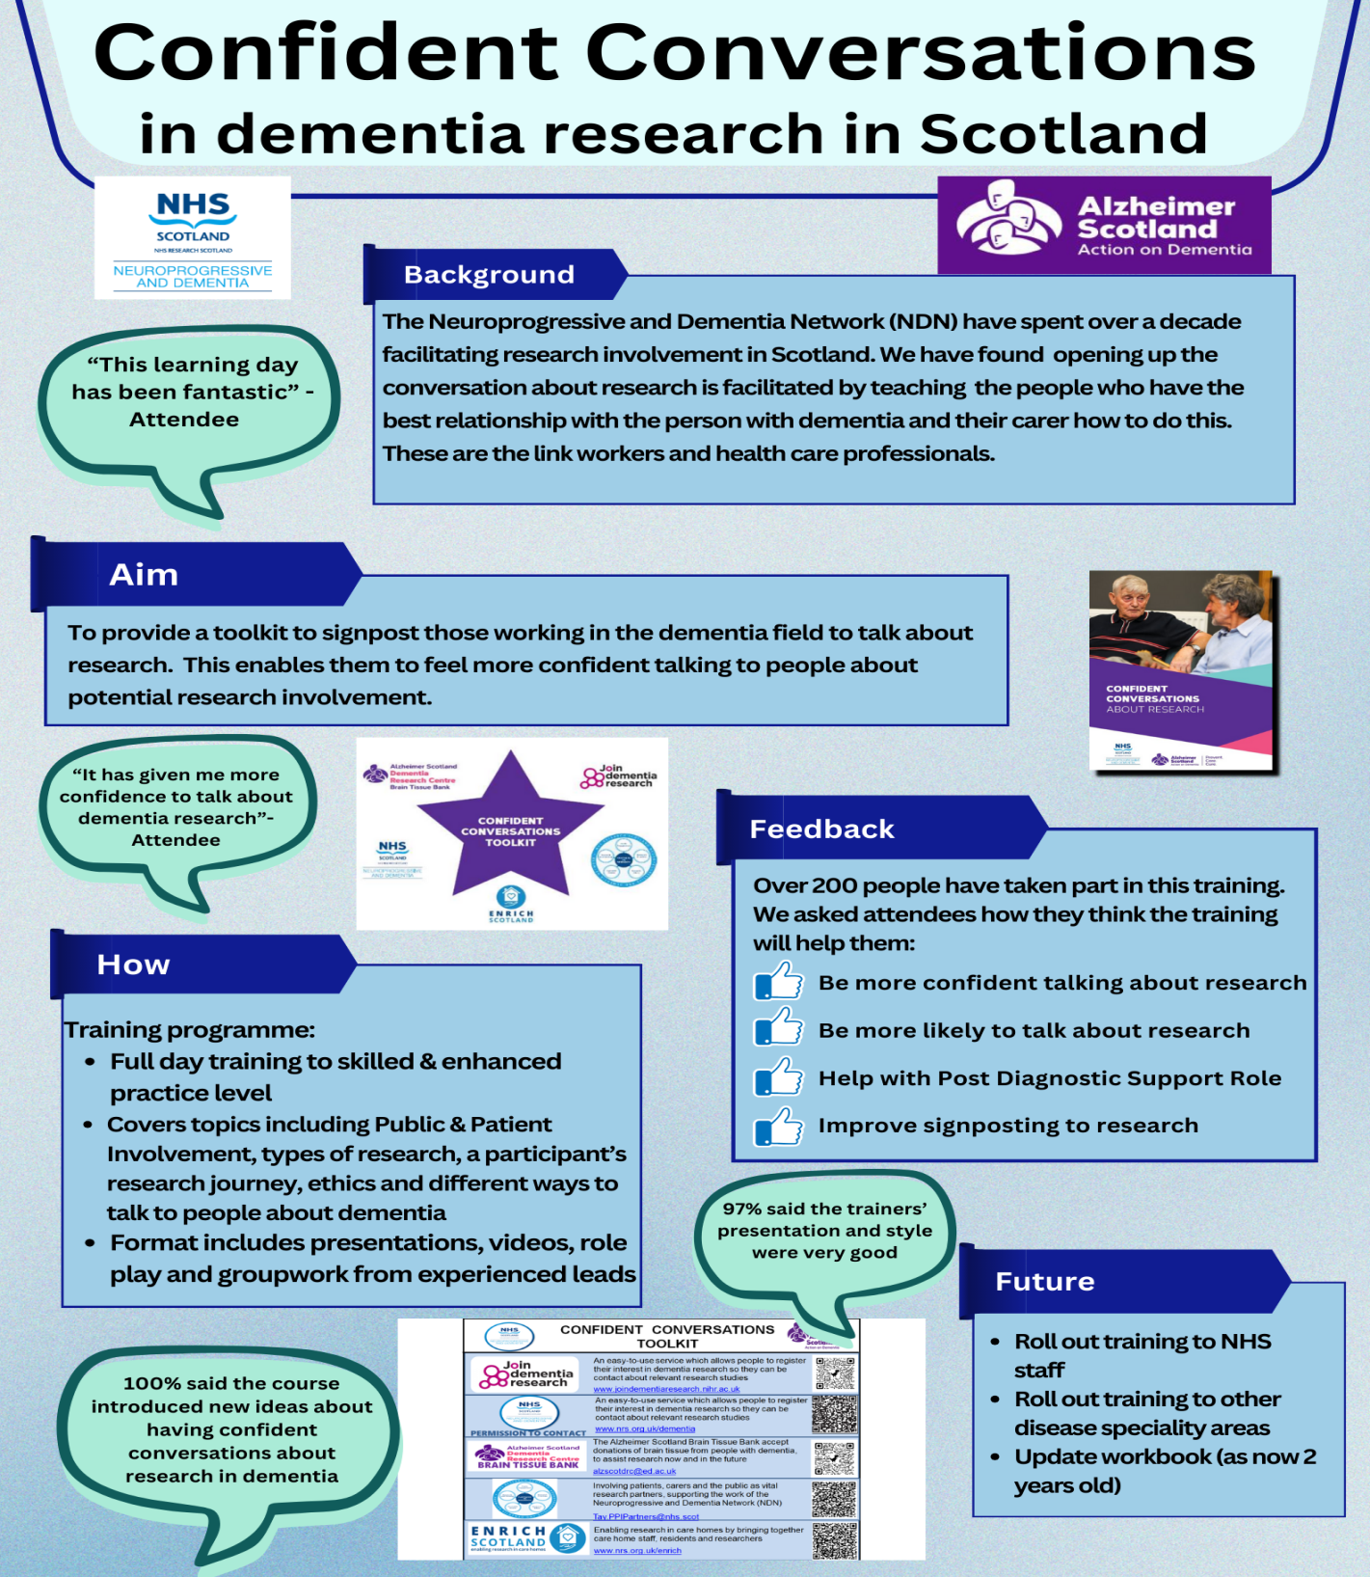

Slide 17
Thank You
Any questions?

